Slide 1
05.10.2018
Document Classification
Thanh Bui, Bertrand Dusanter

Slide 2
Introduction
Big data and data science:
Big data is a term for any collection of data sets so large or complex that they becomes difficult to be processed using traditional data management techniques
Data science involves using methods to analyze massive amounts of data and extract the knowledge it contains
Big data and data science ≈ crude oil and oil refinery
Data science process:
Setting the research goal
Retrieving data
Data preparation
Data exploration
Data modeling
Presentation and deployment

Slide 3
Document classification
1) Research goal:
Recognize scientific documents automatically
Help to better organize documents in the Eramet network and improve CINDOC
2) Retrieving data:
109 scientific documents
64 non-scientific documents

Slide 4
Document classification
Data preparation
Data exploration
Data modeling
(a) Training phase
Machine learning algorithm
Label
Input
Feature extractor
Features
(b) Prediction phase
Trained classifier model
Input
Feature extractor
Features
Label

Slide 5
Document classification
Features:
Number of occurrences of following keywords
Number of pages
keywords = ['abstract', 'al.', 'article', 'authors', 'by', 'doi', 'index', 'institut', 'institute', 'introduction', 'journal', 'keywords', 'laboratory', 'manuscript', 'paper', 'par', 'publication', 'published', 'rapporteur', 'received', 'rev.', 'university']

Slide 6
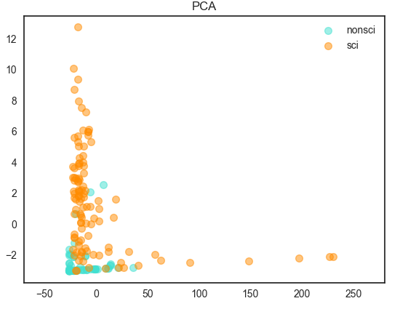
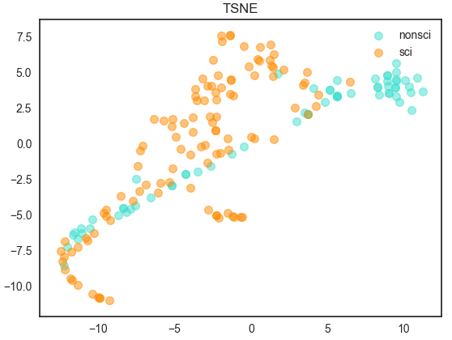
Feature visualisation
Dimensionality reduction

Slide 7
Results
Dataset: 109 scientific documents
64 non-scientific documents
80% for training, 20% for testing
Machine learning models | Testing Accuracy (mean ± std)
Gaussian Naive Bayes | 0.872 ± 0.047
Multinomial Naive Bayes | 0.715 ± 0.068
Support Vector Machines | 0.908 ± 0.045
Random Forest Classification | 0.912 ± 0.047
Gradient Boosting Classification | 0.903 ± 0.047

